Slide 1
Hamiltonian Descent Methods
Chris J. Maddison, Daniel Paulin, Yee Whye Teh, Brendan O’Donoghue and Arnaud Doucet
Presentor: Haoxuan Yang

Slide 2
Main Contributions:
Constant step sizes can be achieved on some convex functions whose second derivatives are singular or unbounded at their minima.
First order gradient information is used to get linear convergences, so only gradient computation is required.
Conformal Hamiltonian dynamics is used to model the motion of a particle.
These methods expand the class of convex function on which linear convergence is possible with first-order gradient.

Slide 3

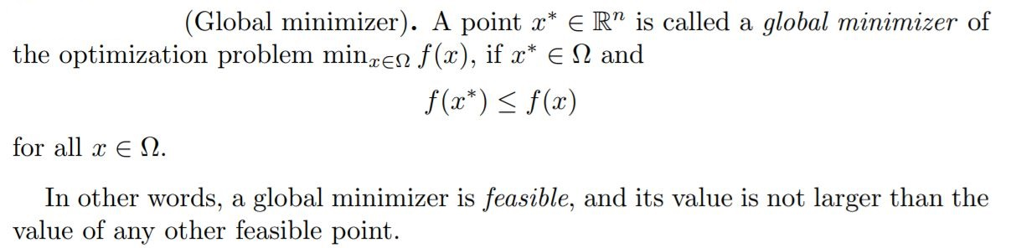
A simple explanation of linear convergence:

Slide 4
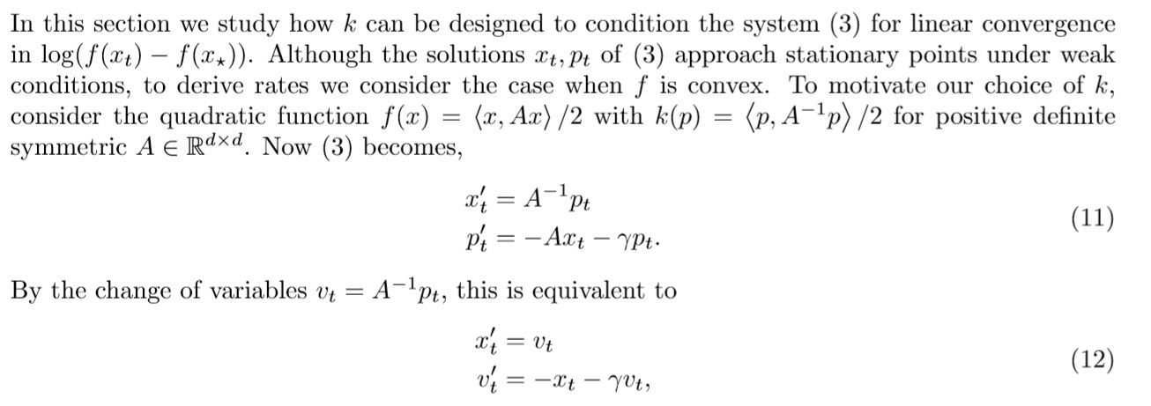
Hamiltonain system

Slide 5
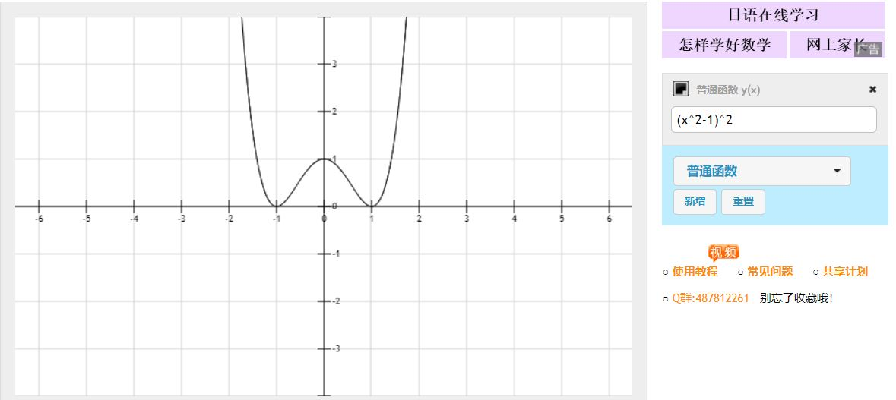
A simple explanation of linear convergence:

Slide 6
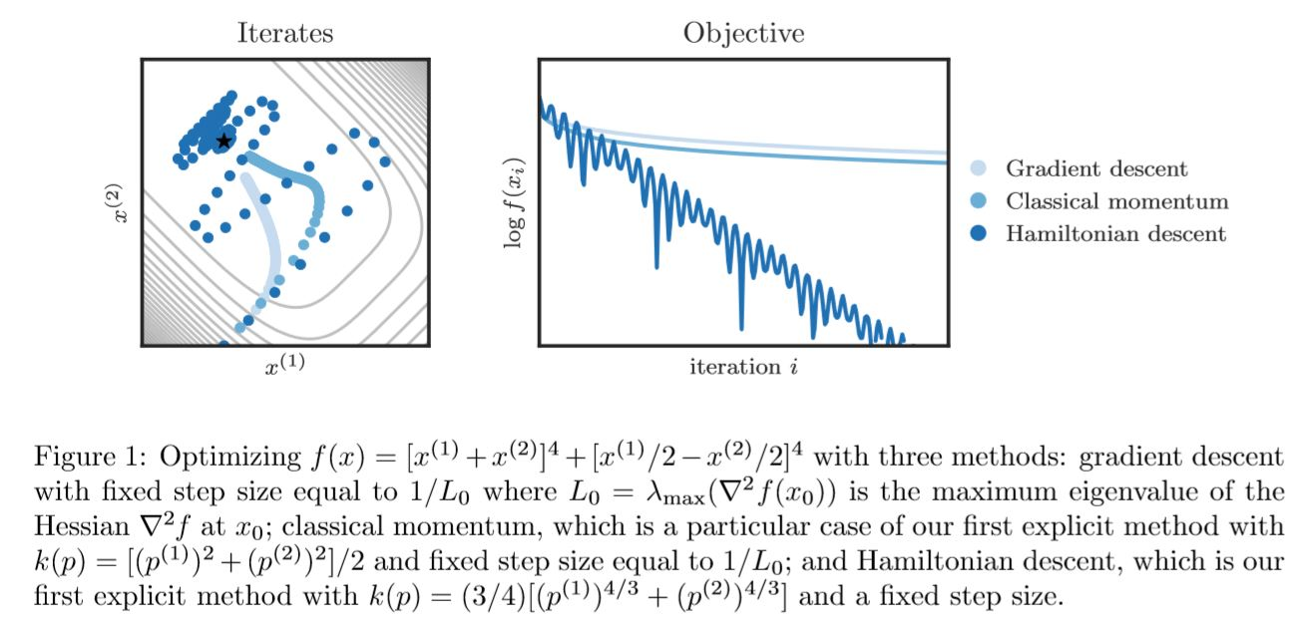
Comparison

Slide 7
How?
The main idea of this paper is to use carefully designed k (k is kinetic energy) in conformal Hamiltonian system to achieve linear convergence.

Slide 8
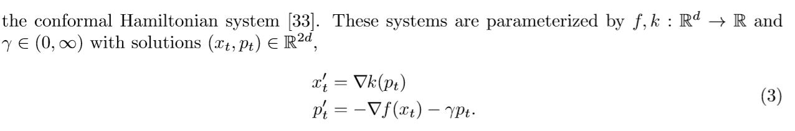
How?

Slide 9


Why use this system? (Big observation: when f is convex!)
This dynamics will guarantee a linear convergence independent of f!

Slide 10

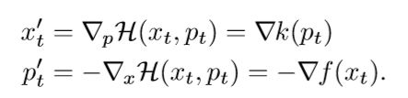
Hamiltonain system

Slide 11
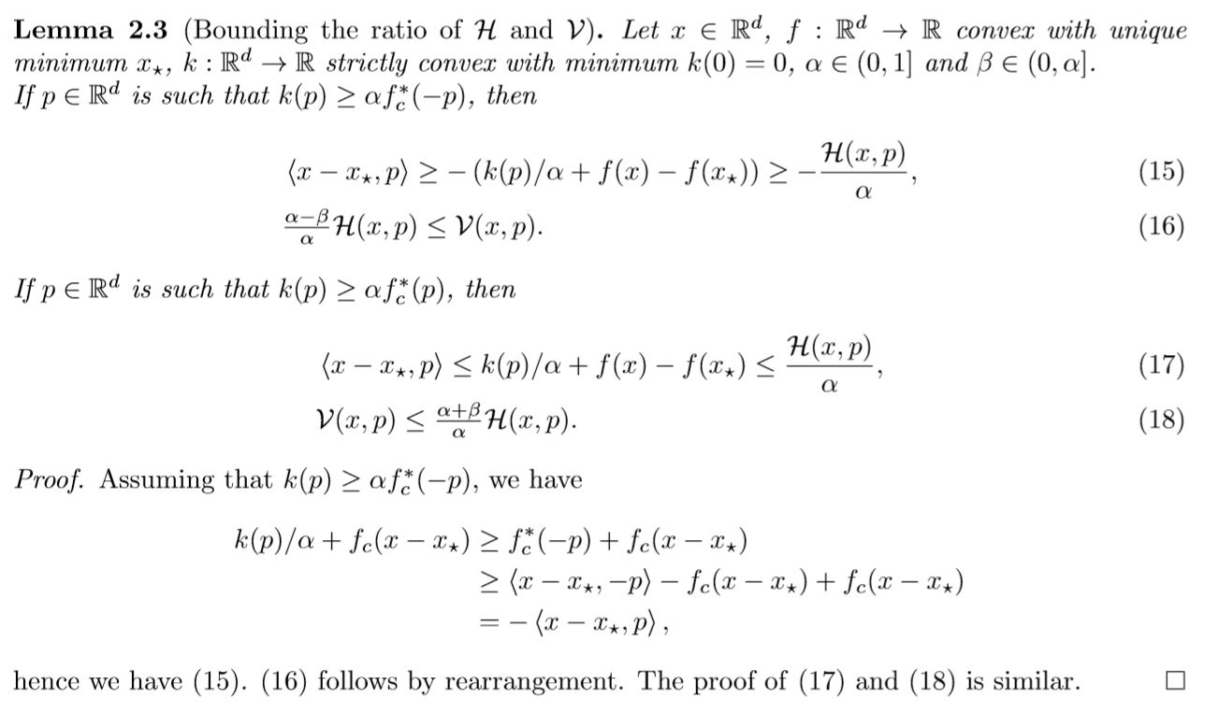
Construct k(p) and beta

Slide 12
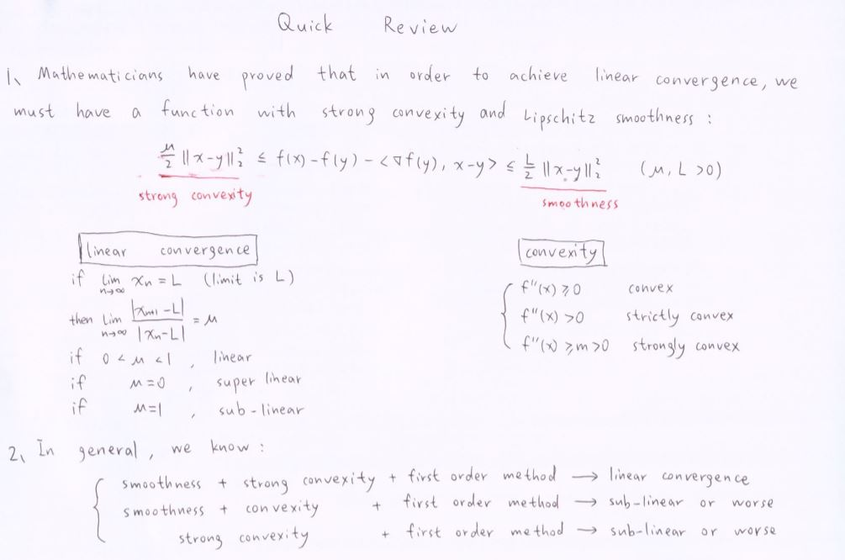
Quick review

Slide 13
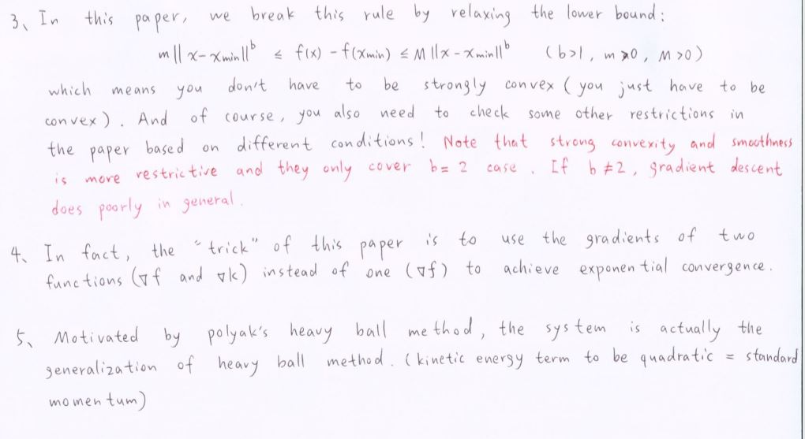
Quick review

Slide 14
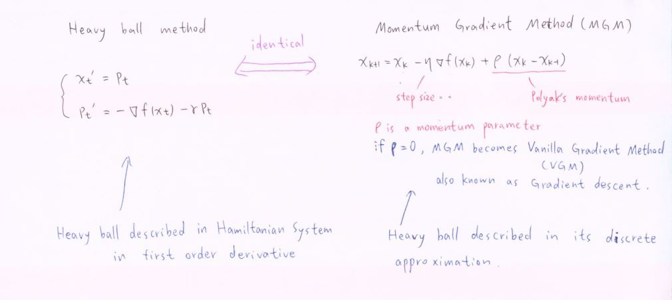
Quick review

Slide 15
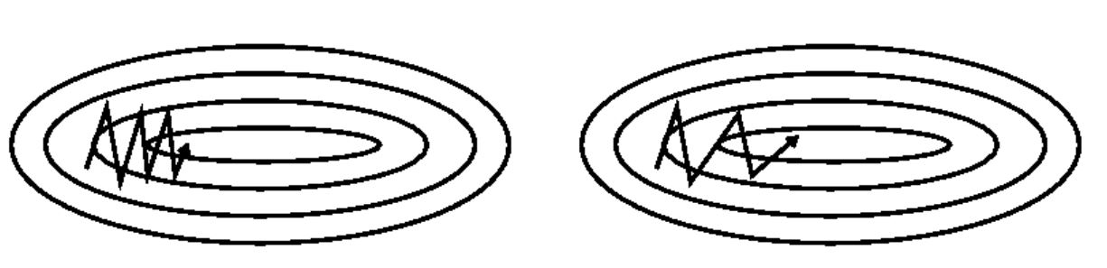
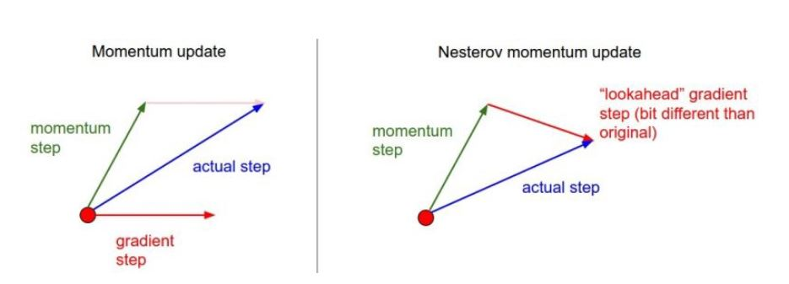
Quick review

Slide 16
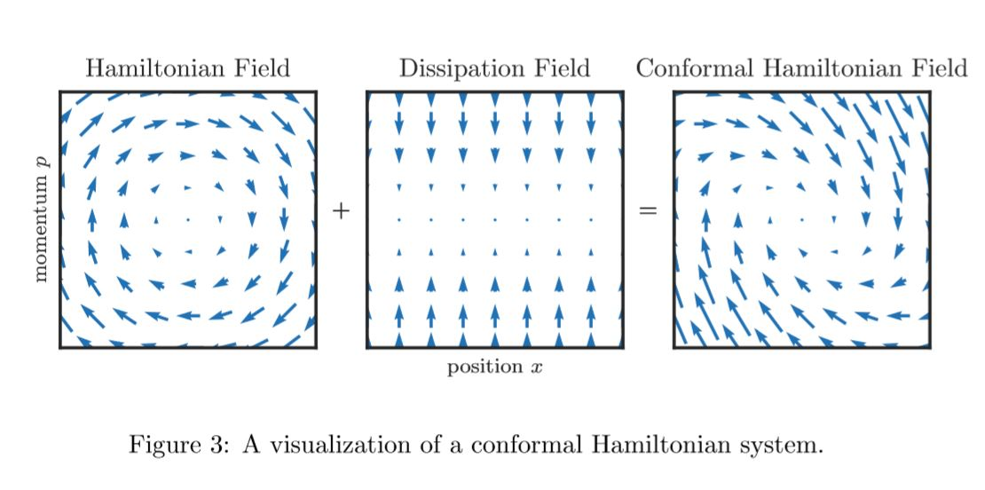




Quick review

Slide 17
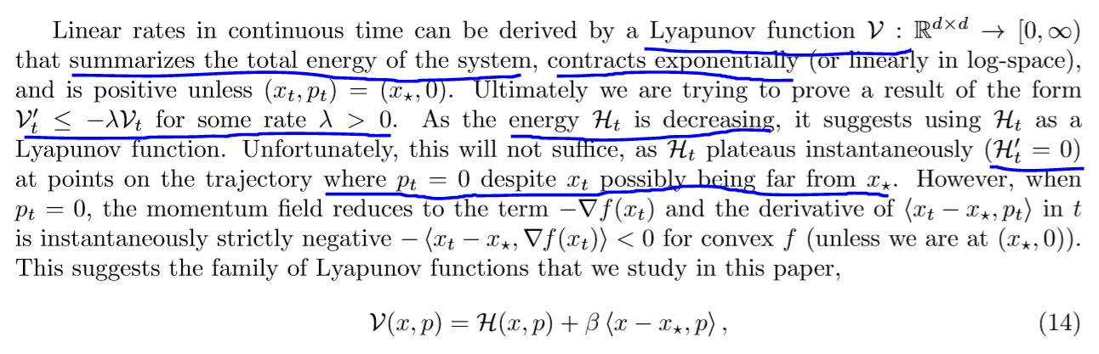
Design energy system

Slide 18
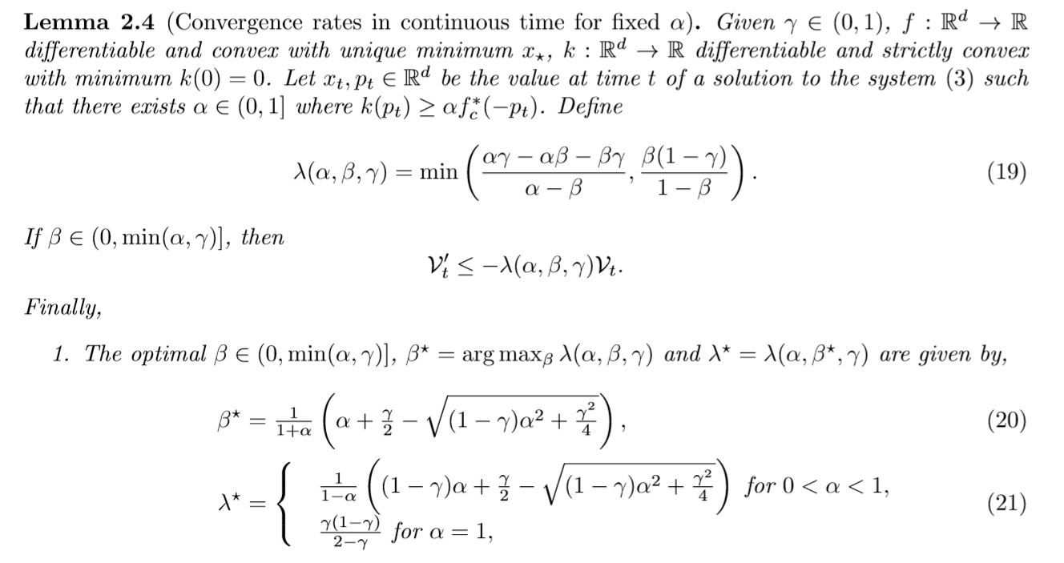
Compute the rate

Slide 19
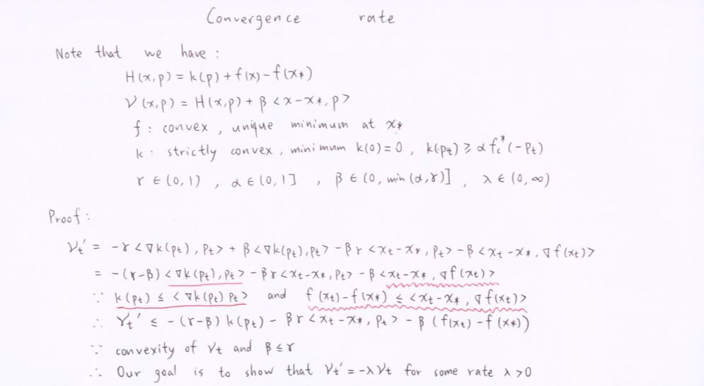
Convergence Rate Proof

Slide 20
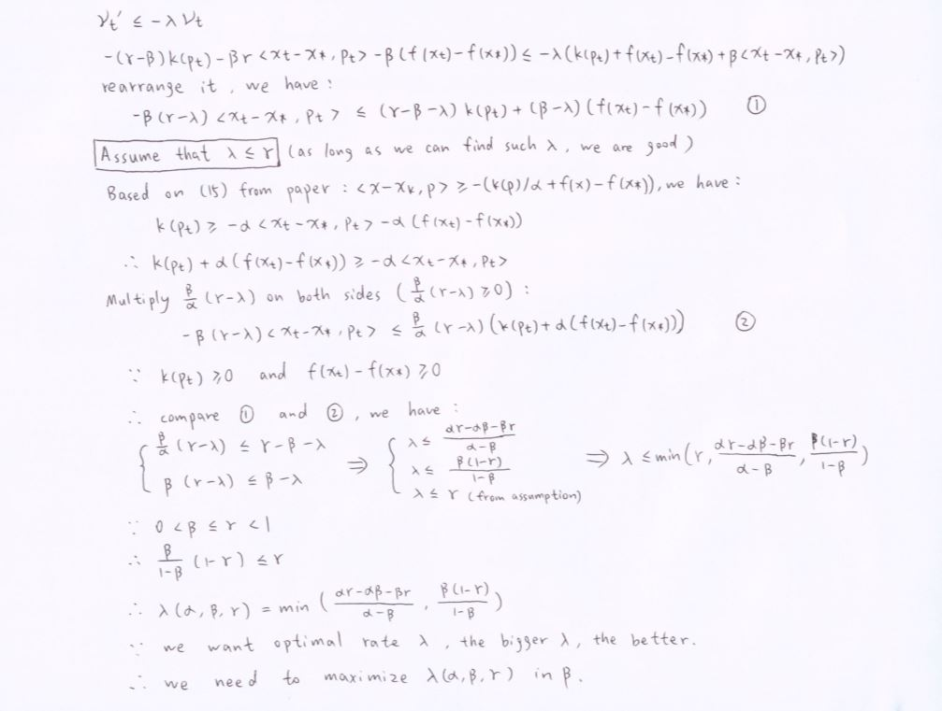
Convergence Rate Proof

Slide 21
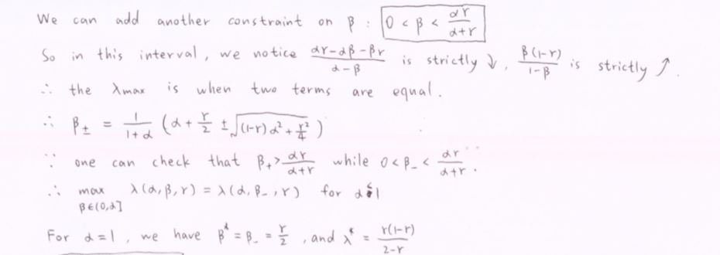
Convergence Rate Proof

Slide 22
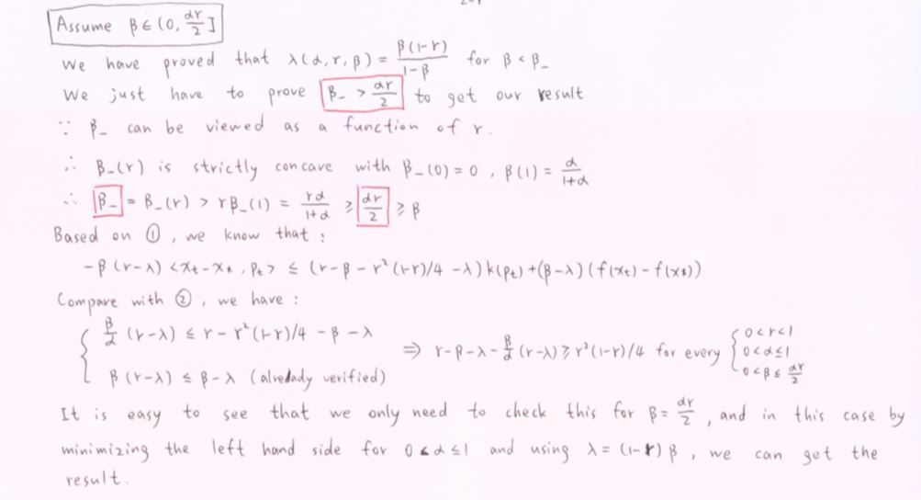
Convergence Rate Proof

Slide 23
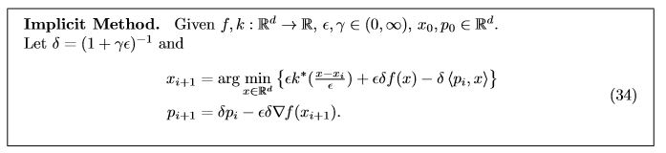
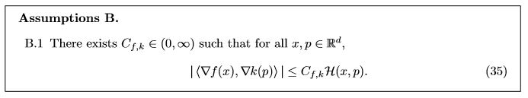
Optimization

Slide 24
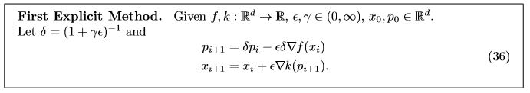
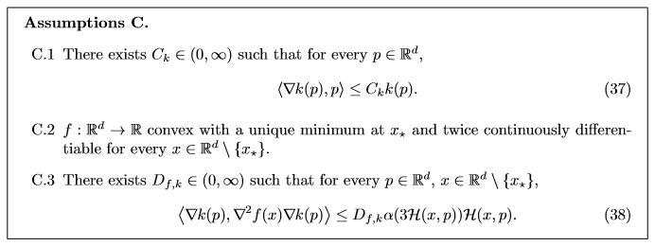
Optimization

Slide 25
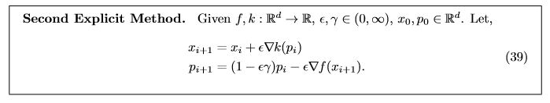
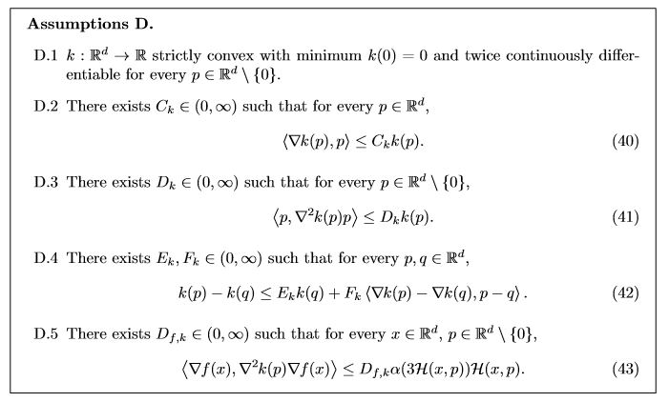
Optimization

Slide 26
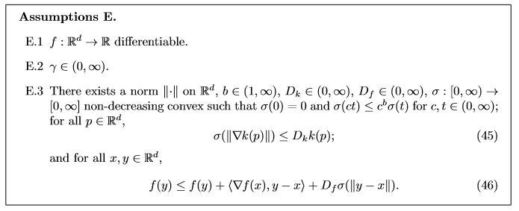
Optimization

Slide 27
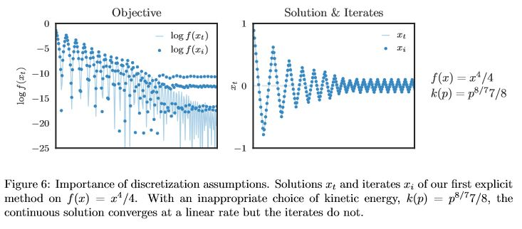
Optimization

Slide 28
Question?

